Slide 1
Cloud & Serverless Computing
Real Time Aws Console Login Alerts

Slide 2

Services Used
Lambda
Key management System
Cloud Trail
Amazon S3
IAM

Slide 3






Event captured
Rule Triggered
Invoke Lambda
login
Execute Bot

Slide 4
Lambda
Serverless Computing
Event driven
Scalability
Pay-per-use
Integrations

Slide 5
Key management Service
Encryption
Customer Masker Keys
Key Policies
Integration
Compliance

Slide 6
Cloud Trail
Logging
Management
Integration
Security
Compliance

Slide 7
Amazon S3
Object Storage
Scalability
Durability and Availability
Security
Integration

Slide 8
IAM
Identity Management
Granular Permissions
Centralized Control
Integration
Security

Slide 9
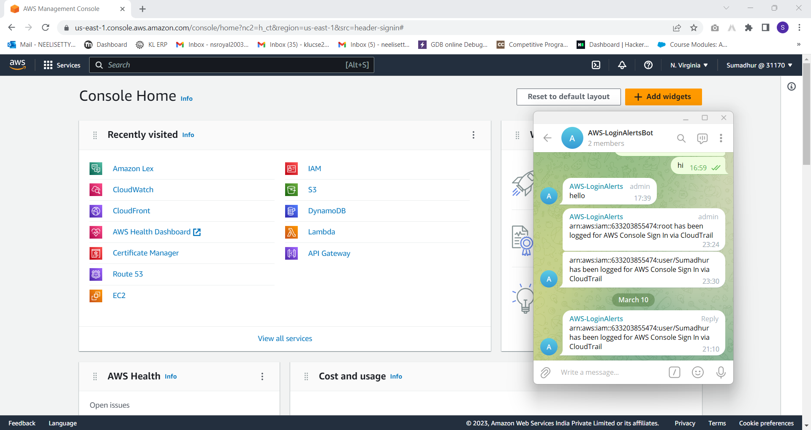
Results:

Slide 10


